Slide 1
User Analytics in the
Telecommunication Industry
TellCo customer overview, engagement, experience and satisfaction analysis
Python
MySQL
Power BI
K-Means
Final Project Presentation
Prepared by Ankita Mohanty

Slide 2
Business Context & Analytical Objectives
Investor due diligence for TellCo
Business need
1
User Overview
Handsets, sessions, traffic, applications
Assess customer behavior, network quality and growth opportunities before making a purchase decision.
2
Engagement
Frequency, duration, traffic, K-Means
Decision focus
Identify profitable usage patterns, service quality risks and customer segments that can support future growth.
3
Experience
RTT, throughput, TCP retransmission
4
Satisfaction
Scores, regression, clustering, SQL export

Slide 3
Data & Preparation
Cleaning and feature preparation before analysis
Rows
Variables
SQL sample
Power BI
150,001
55
9,741
10,000
full Python dataset
network, device & app fields
imported rows
dashboard sample rows
Missing numerical values were handled with mean imputation; categorical values used mode where appropriate.
Outliers were inspected with box plots and treated consistently with the project brief.
Customer-level aggregates were created for engagement, experience and satisfaction scoring.
Application traffic was combined across download and upload bytes for business interpretation.

Slide 4
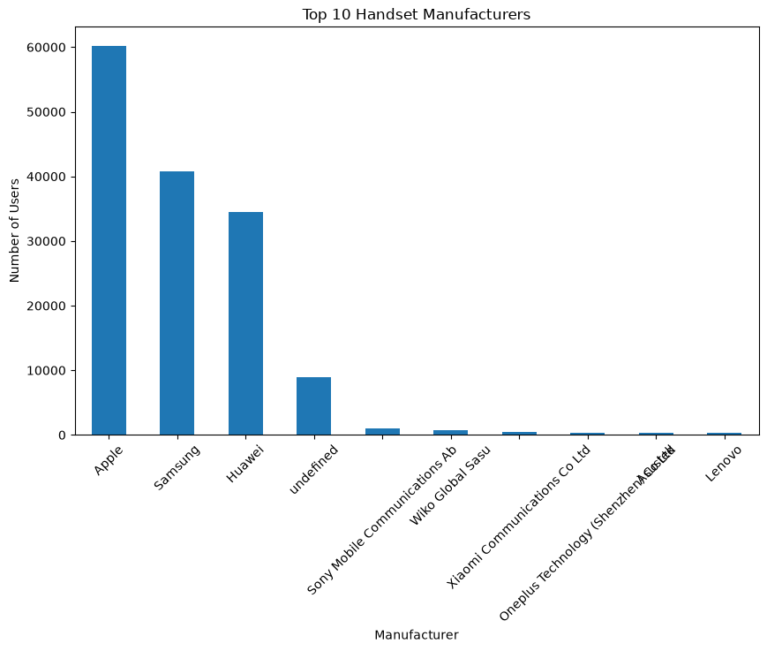
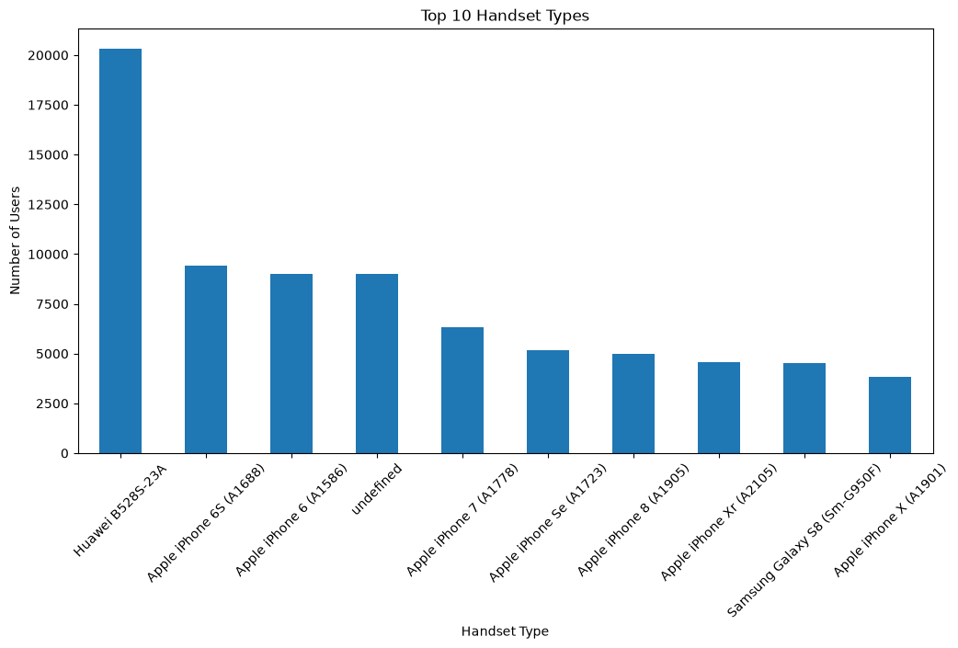
Task 1 — User Overview: Handset Landscape
Device concentration is high among a few manufacturers and models
Key takeaway
Apple, Samsung and Huawei dominate manufacturer usage, while Huawei B528S-23A is the single most common handset model. Device concentration supports targeted device partnerships and support strategies.

Slide 5
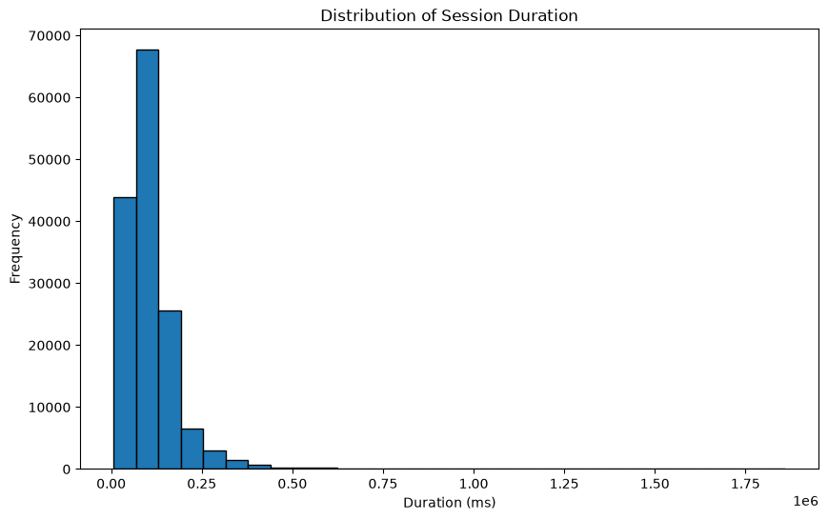
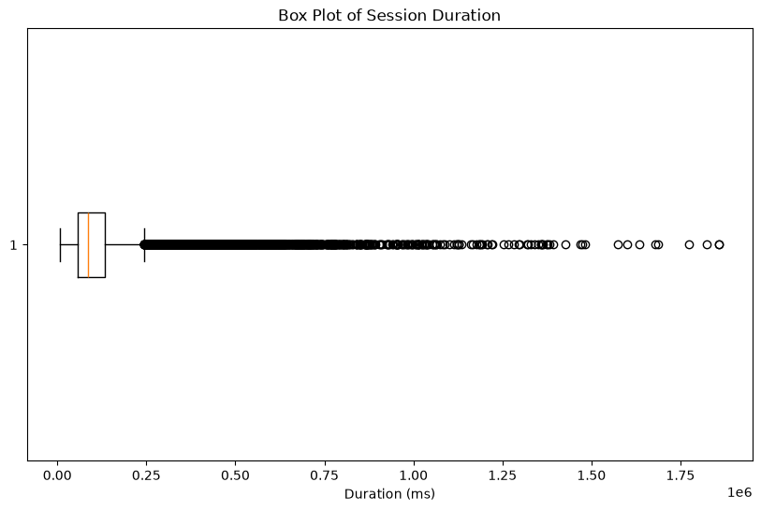
Exploratory Data Analysis
Session duration is strongly right-skewed and contains long-session outliers
Interpretation
Most sessions are relatively short, while a smaller number of very long sessions create a long tail. This supports robust outlier treatment before clustering.

Slide 6
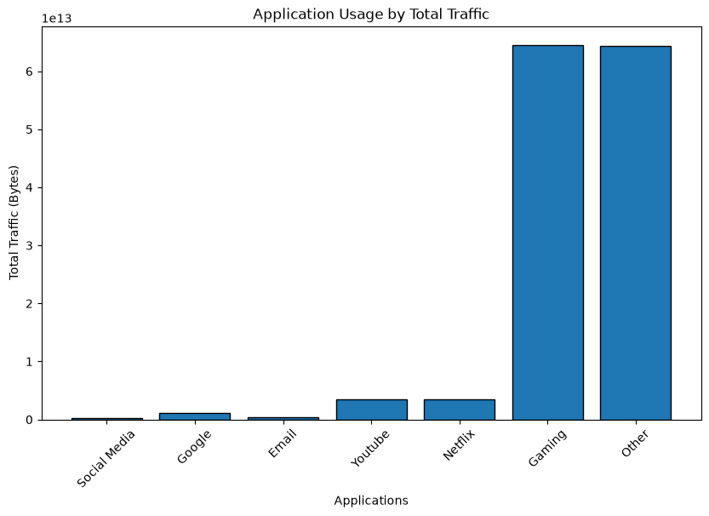
Task 1 — Application Usage
Entertainment traffic dominates total network demand
Largest traffic drivers
Gaming and Other applications account for the largest share of total traffic.
Secondary demand
YouTube and Netflix are the next major traffic consumers, highlighting video-heavy usage.
Business implication
Prioritize bandwidth planning and capacity management around entertainment-heavy usage periods.

Slide 7
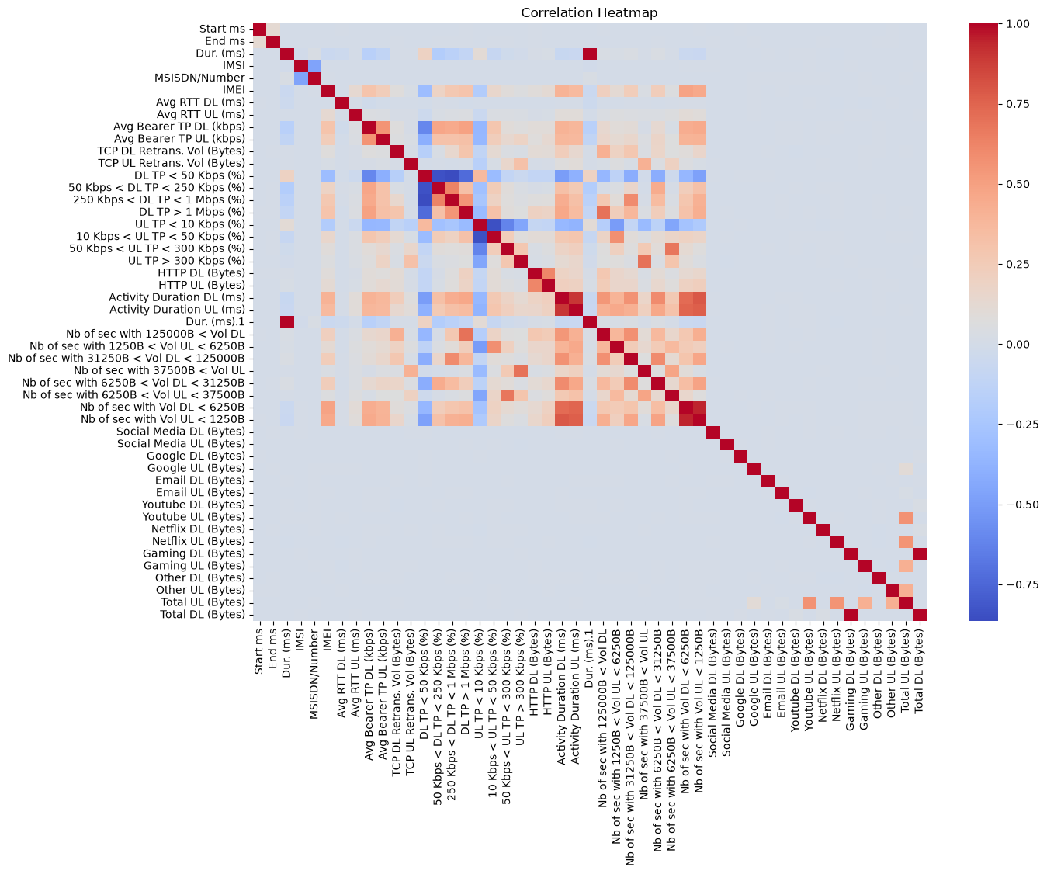
Correlation & Dimensionality Reduction
PCA shows application behavior is spread across multiple dimensions
PC1 variance
PC2 variance
14.83%
14.55%
first component
second component
Combined variance
29.38%
two components together
Interpretation
Two components retain less than one-third of total variation, so application usage cannot be represented well by only two dimensions.

Slide 8
Task 2 — User Engagement Analysis
Customer activity segmented using frequency, duration and total traffic
Metric 1
Metric 2
Metric 3
Session frequency
Session duration
Total traffic
number of xDR sessions
total duration per customer
DL + UL bytes
Normalization
K-Means
Top applications
Engagement metrics were standardized before clustering to prevent scale dominance.
Users were segmented into 3 engagement clusters. The elbow method was used to evaluate the optimized k.
Gaming, Other and YouTube were among the highest traffic applications, guiding resource allocation.
Business use: target high-engagement users with premium offers while building activation strategies for low-engagement segments.

Slide 9
Task 3 — User Experience Analysis
Network quality was assessed using RTT, throughput and TCP retransmission
Avg DL RTT
Avg UL RTT
Avg DL throughput
Avg UL throughput
122.46 ms
18.91 ms
22,367.72 kbps
2,885.36 kbps
SQL sample
SQL sample
SQL sample
SQL sample
Avg DL TCP retransmission
Avg UL TCP retransmission
13.60 MB
0.49 MB
SQL sample
SQL sample
Experience clustering
Customers were grouped into 3 experience clusters using normalized TCP retransmission, RTT and throughput metrics. The least favorable cluster was used as the reference for experience scoring.

Slide 10
Task 4 — Satisfaction Analysis
Satisfaction combines distance from low engagement and poor experience clusters
Final customers
More satisfied
Less satisfied
8,341
2,673
5,668
unique scored users
cluster 0
cluster 1
Satisfaction cluster distribution
Cluster averages
More satisfied cluster: satisfaction ≈ 2.375. Less satisfied cluster: satisfaction ≈ 1.562.
32% more satisfied
Regression caveat
Linear regression produced R² ≈ 1.0 because satisfaction was mathematically defined as the average of the same two predictor scores. This is not evidence of real-world predictive perfection.
68% less satisfied

Slide 11
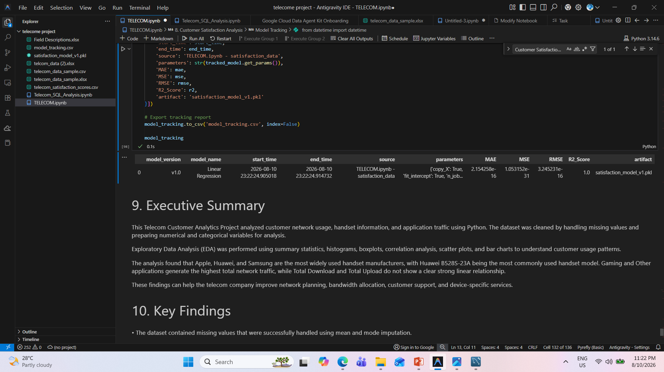
Model Tracking Evidence
Lightweight tracking artifact created for the satisfaction regression model
Tracked
Model version, model name, start/end time and data source.
Metrics
MAE, MSE, RMSE and R² recorded for the run.
Artifacts
model_tracking.csv and satisfaction_model_v1.pkl saved.
Note: this is tracking evidence, not a full production deployment pipeline.

Slide 12
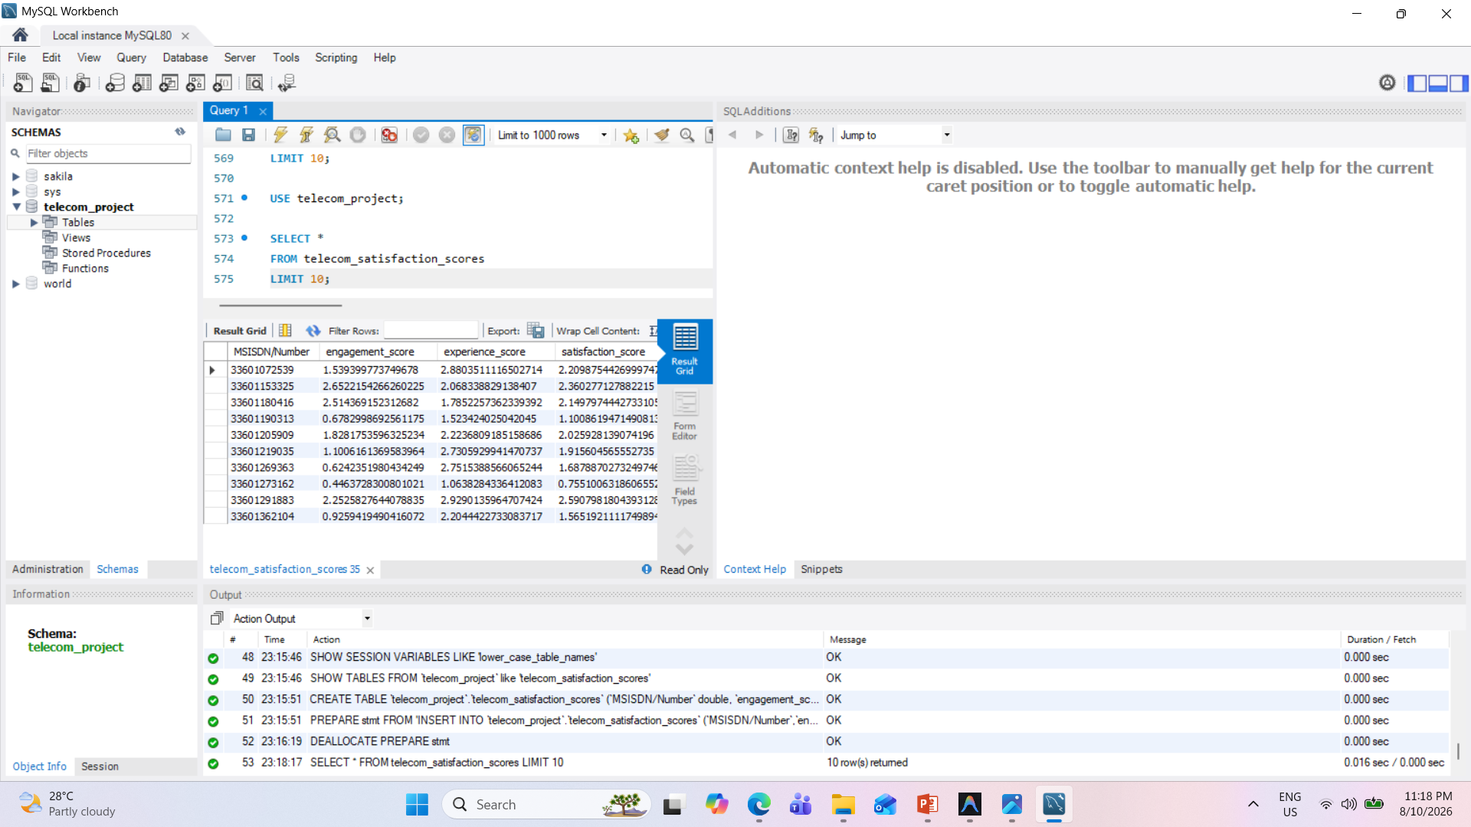
Task 4.6 — MySQL Export
Final satisfaction score table successfully stored and queried
Required columns
MSISDN/Number, engagement_score, experience_score, satisfaction_score
Verification
SELECT * FROM telecom_satisfaction_scores LIMIT 10 returned the expected data.
Purpose
Provides persistence and reproducibility of the final customer score table.

Slide 13
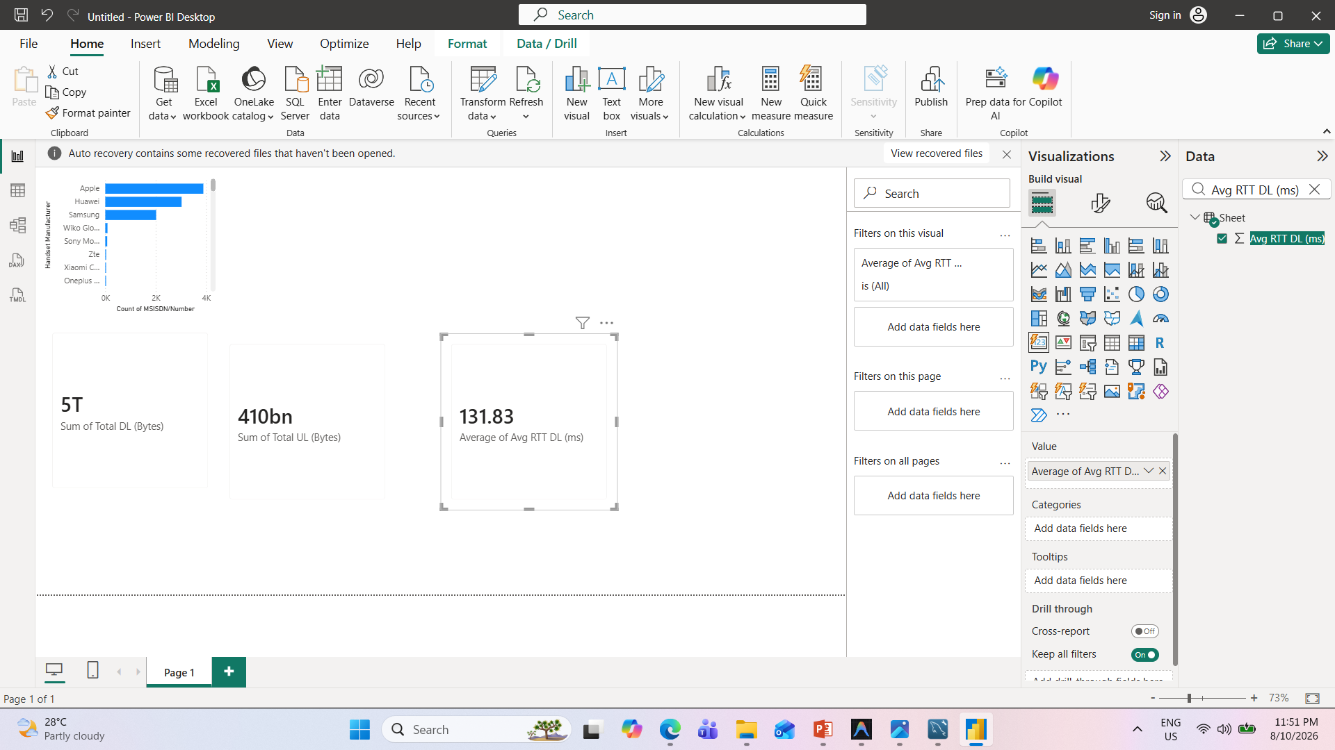
Power BI Dashboard
Compact dashboard view for stakeholder communication
Download
~5T bytes
sample dashboard
Upload
~410bn bytes
sample dashboard
Avg DL RTT
131.83 ms
sample dashboard
Top manufacturers are also visible for rapid executive review.

Slide 14
Key Business Insights
What the analysis says about TellCo’s customer base and network
Traffic concentration
Device concentration
Gaming and Other applications dominate demand, with YouTube and Netflix also significant.
Apple, Samsung and Huawei account for most handset usage; Huawei B528S-23A is highly prevalent.
Download-heavy network
Segment opportunity
Download traffic materially exceeds upload traffic, pointing to content-consumption behavior.
Engagement and satisfaction clusters provide a basis for differentiated retention and monetization strategies.
Experience risk
Satisfaction gap
RTT and retransmission metrics show that network quality should remain a core investment priority.
About two-thirds of scored users fall in the less-satisfied cluster, creating a meaningful improvement opportunity.

Slide 15
Growth Recommendations
Actions that can improve revenue potential and customer experience
1
Invest in network capacity
Prioritize gaming/video traffic hotspots and monitor RTT, throughput and retransmission.
2
Target high-value segments
Use engagement and satisfaction scores for retention, premium plans and personalized offers.
3
Build device partnerships
Focus commercial bundles and support around Apple, Huawei and Samsung ecosystems.
4
Improve low-satisfaction journeys
Investigate low-experience and low-engagement users before churn develops.
5
Operationalize analytics
Refresh customer scores, dashboards and model tracking on a regular schedule.

Slide 16
Limitations
Important boundaries on interpretation
The Power BI and SQL views used sample subsets, while the primary Python analysis used the full telecom dataset.
Mean/mode imputation and outlier replacement can reduce natural variability and influence clustering results.
PCA with two components explains only 29.38% of application-usage variance.
The satisfaction regression target is constructed directly from engagement and experience scores, making R² ≈ 1.0 structurally expected.
No revenue, cost, churn, pricing, market-share or capital-expenditure data were included in this analysis.
Model tracking was implemented, but a full CI/CD, Docker and production monitoring pipeline was not deployed.
Decision implication
The recommendation should be treated as operational/customer-analytics evidence and combined with financial due diligence before acquisition.

Slide 17
Investment Recommendation
Proceed with a conditional BUY, subject to financial and network-capex validation
Why buy
BUY
Strong traffic demand, large engaged segments, device concentration that enables focused partnerships, and measurable satisfaction improvement opportunities.
Conditional recommendation
Conditions
Customer demand is substantial, segmentation opportunities are clear, and operational improvements can create upside.
Validate revenue quality, churn, ARPU, infrastructure capex, coverage and competitive position before final transaction approval.
First 90 days after acquisition
Prioritize network quality, high-usage customer retention, gaming/video capacity planning and recurring analytics refreshes.

Slide 18
References & Submission Checklist
Final deliverables prepared for the project brief
Project brief: Nexthikes IT Solutions — User Analytics in the Telecommunication Industry.
Telecom xDR dataset and Field Descriptions workbook.
Python analysis notebook: TELECOM.ipynb / TELECOM_GitHub.ipynb.
SQL analysis notebook: Telecom_SQL_Analysis.ipynb.
MySQL export table: telecom_satisfaction_scores.
Power BI file: Telecom_Customer_Analytics_Dashboard.pbix and dashboard screenshot.
Model artifacts: model_tracking.csv and satisfaction_model_v1.pkl.
Before submission: add the final GitHub repository URL(s) to this slide.
18 slides total
Within 20-slide limit
Dashboard included
Buy recommendation included

